Slide 1
Heart Disease Prediction
By Zakaria Chowdhury

Slide 2
Agenda
Problem & dataset
Methodology (preprocessing, feature selection, split, evaluation)
Models: Logistic Regression, Decision Tree, SVM
Results & comparison

Slide 3
Problem and Dataset
Problem Definition
Goal: Predict whether a patient has heart disease using clinical data.
Type of problem: Binary classification — the output is either:
0: No heart disease
1: Presence of heart disease
This is a medical diagnosis task, where minimizing false negatives is especially important (i.e., not missing someone who has the disease).
Mix of numerical and categorical variables:
Numerical: Age, cholesterol, resting blood pressure, max heart rate, etc.
Categorical (some numeric-looking): Sex, chest pain type, fasting blood sugar, ECG results, exercise-induced angina

Slide 4
Methodology
Dataset loading & target detection
Reads the heart.csv file.
Binarizes target if multiclass.
Train/Test split
Splits data before any encoding.
Stratified split to maintain class balance.
Preprocessing (One-hot encoding)
Finds which columns have categories (like “yes”/“no” or a few different groups).
Changes these categories into numbers the model can understand (turns each category into its own column).
Makes sure the test data has the same columns as the training data.
Correlation calculation (train only)
Checks how much each feature is connected to the target (using training data only).
Sorts the features to find the ones most related to the outcome.

Slide 5
Column Correlation

Slide 6
Top‑K Train‑Correlated Features (K=12)
1. ST slope
2. exercise angina
3. chest pain type
4. max heart rate
5. oldpeak
6. sex
7. age
8. fasting blood sugar
9. cholesterol
10. resting bp s
11. resting ecg

Slide 7
Methodology
Models: Logistic Regression = simple probability baseline
Decision Tree = readable if–then rules
SVM = flexible boundary (needs scaling)
Evaluation: Table = precision, recall, F1, accuracy;
Matrix = TN/FP/FN/TP
Plan: Train all three models on the highest correlation features and compare test accuracy

Slide 8
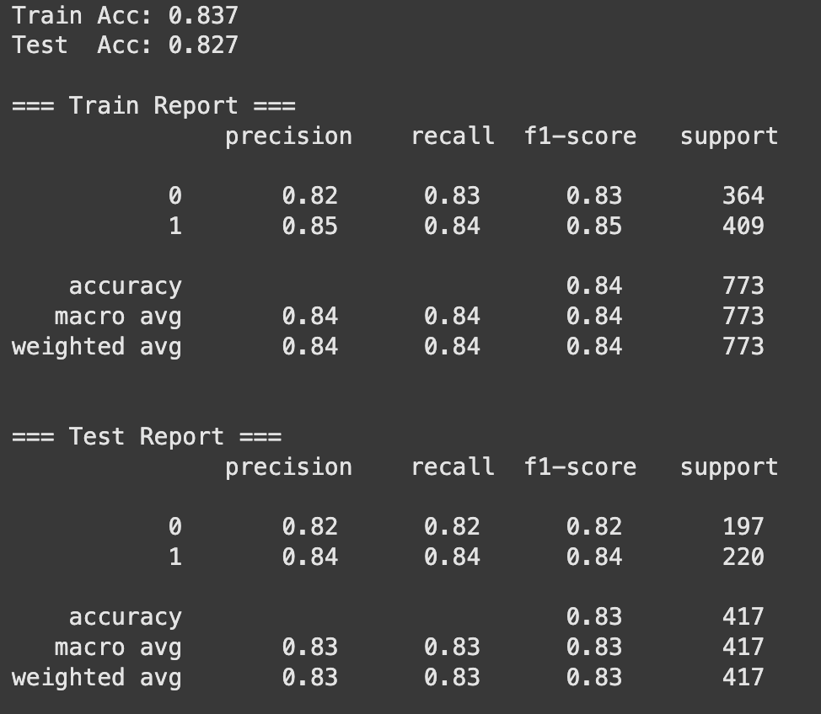
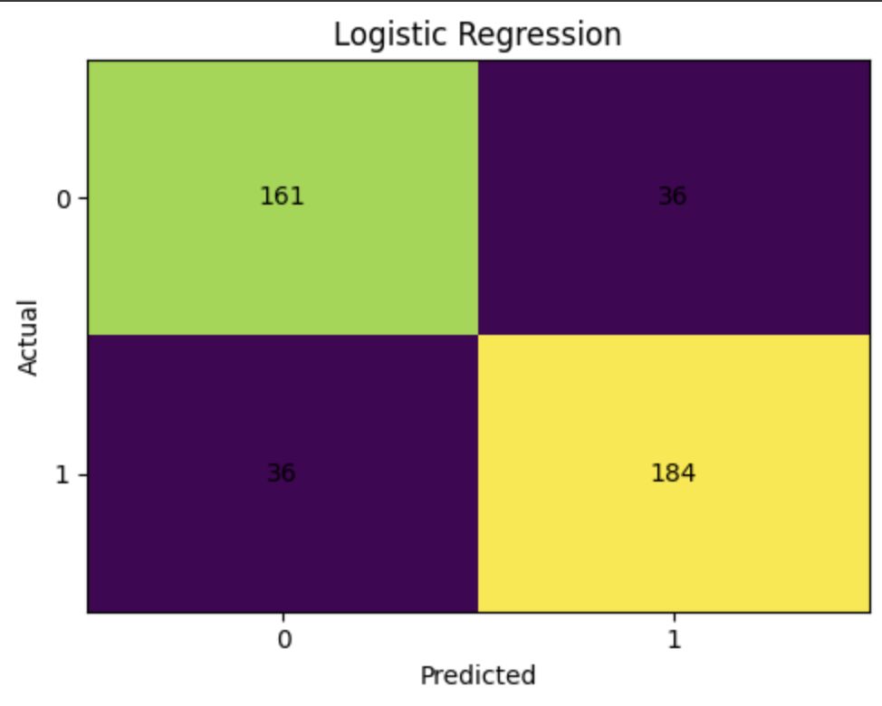
Logistic Regression

Slide 9
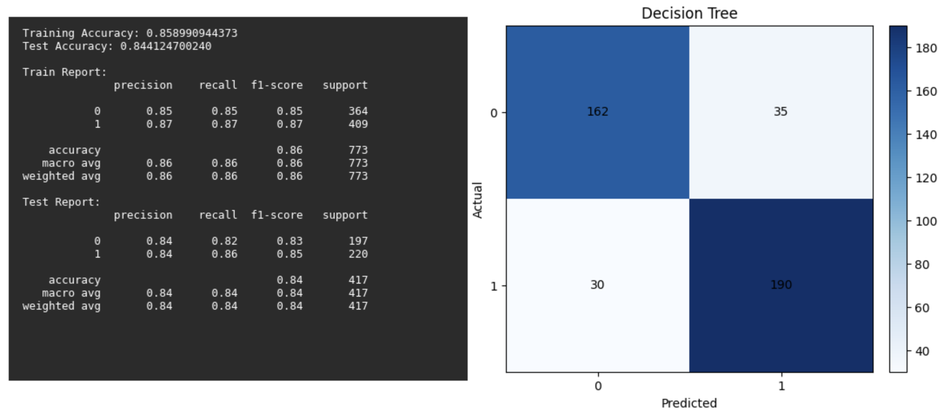
Decision Tree

Slide 10
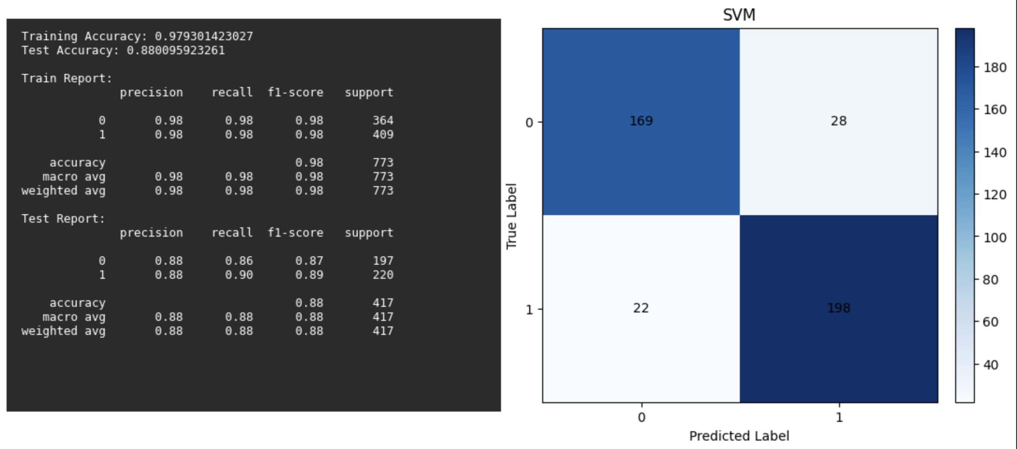
SVM

